Slide 1

Data Base
Final Project
Clinic Management System
© Nevo Sharabi, Jaacov Biblow(ben ari), Yaniv Erlich

Slide 2

System Requirements – The new Data Base will provide an efficient way to manage the clinic’s data, manage the doctors schedule and keep track of their session and prescriptions. The system also manages the patient medical history by keeping a record of the patient’s previous sessions including his analysis and diagnosis.

Slide 3
General Description
A Clinic has a name and address. The clinic has Doctors and a managing doctor. Patients makes appointments to get treated by a doctor in the clinic.
In a Clinic there are several doctors that have a doctor id , first name, last name , dob,age, gender and years of experience.
Each doctor has a work schedule containing the day and starting hour and ending hour that he’s available for sessions to treat patients.
The patients coming to the clinic have a patient id,first name, last name , age ,dob and gender.
A session between a patient and a doctor occours in a specific room and might result in an analysis or a diagnosis and a prescription given by the doctor.
Prescription contains issue date and lines, each line contains medicine and a dose .
Each room has a number and a specific type.

Slide 4
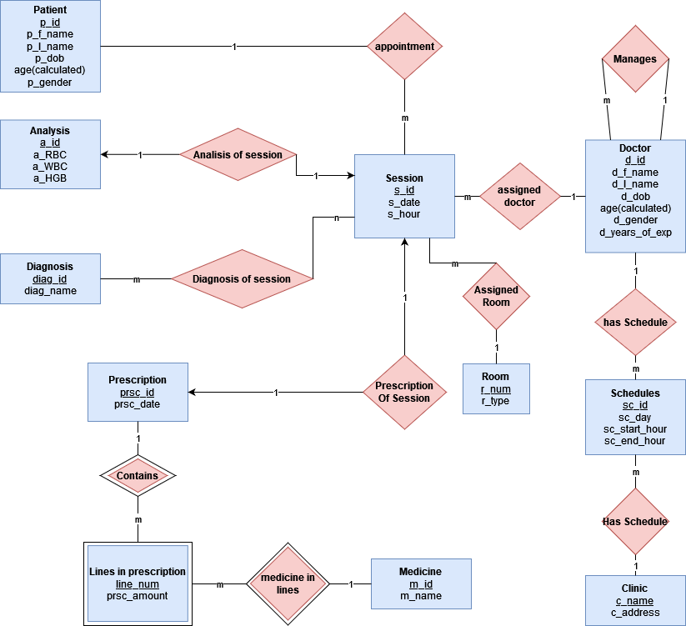
Logical ERD

Slide 5
Entities Description
PK, FK
Clinic – Name, Address.
Schedule– sc_id, sc_day, sc_start_hour, sc_end_hour,d_id ,c_name
Doctor – d_id, d_f_name, d_l_name,d_dob,d_age,d_gender,d_years_of_exp,manager_id
Patient– p_id, p_f_name, p_last_name,p_gender,p_dob,p_age
Session – s_id, s_date, s_hour, d_id, p_id,r_num
Room – r_num, r_type
Analysis – a_id, a_RBC,a_WBC,a_HGB,s_id
Diagnosis– diag_id,diag_name
Diagnosis of Session– diag_id , s_id
Prescription– prsc_id,prsc_date,s_id
Medicine – m_id,m_name
Lines in prescription– line_num,lip_amount,m_id,prsc_id

Slide 6
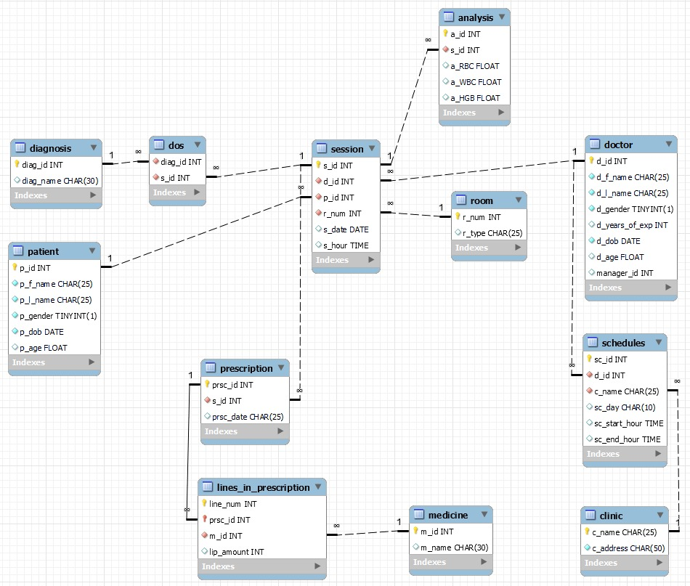
Physical ERD

Slide 7

There are three types of users that use the system:
Patient:
The patient makes an appointment for a session, may view their future appointments and see information about their past appointments including the prescription, analysis and diagnosis that was given to them.
Doctor:
A doctor can view his work schedule, view the medical history (past analysis and diagnosis) of his patients and all the prescriptions he has given.
Managing Doctor:
The managing doctor is in charge of the schedule of the doctors and view all the information of the system including the sessions between the doctors and patients.

Slide 8

The SQL Code

Slide 9
Creating The Tables
Clinic:
CREATE TABLE Clinic(c_name CHAR(25) NOT NULL,
c_addressCHAR(50) NOT NULL,
PRIMARY KEY(c_name))
ENGINE = InnoDB;
Doctor:
CREATE TABLE Doctor ( d_id INT NOT NULL,
d_f_name CHAR(25) NOT NULL,
d_l_name CHAR(25) NOT NULL,
d_gender BOOL NOT NULL,
d_years_of_exp INT,
d_dob DATE NOT NULL,
d_age FLOAT, manager_id INT,
PRIMARY KEY (d_id)) ENGINE=INNODB;

Slide 10
Patient:
CREATE TABLE Patient
( p_id INT NOT NULL,
p_f_name CHAR(25) NOT NULL,
p_l_name CHAR(25) NOT NULL,
p_gender BOOL NOT NULL,
p_dob DATE NOT NULL,
p_age FLOAT,
PRIMARY KEY (p_id)) ENGINE=INNODB;
Schedule:
CREATE TABLE Schedules
( sc_id INT NOT NULL,
d_id INT NOT NULL,
c_name CHAR(25) NOT NULL,
sc_day CHAR(10),
sc_start_hour TIME,
sc_end_hour TIME,
PRIMARY KEY (sc_id),
CONSTRAINT fk_doctor_id_1 FOREIGN KEY (d_id) REFERENCES Doctor (d_id),
CONSTRAINT fk_clinic FOREIGN KEY (c_name) REFERENCES Clinic (c_name))
ENGINE=INNODB;
Room:
CREATE TABLE Room
( r_num INT NOT NULL,
r_type CHAR(25),
PRIMARY KEY (r_num))
ENGINE=INNODB;
Session:
CREATE TABLE Session
( s_id INT NOT NULL,
d_id INT NOT NULL,
p_id INT NOT NULL,
r_num INT NOT NULL,
s_date DATE,
s_hour TIME,
PRIMARY KEY (s_id),
CONSTRAINT fk_doctor_id_2 FOREIGN KEY (d_id) REFERENCES Doctor (d_id),
CONSTRAINT fk_patient_id_1 FOREIGN KEY (p_id) REFERENCES Patient (p_id),
CONSTRAINT fk_room_num_1 FOREIGN KEY (r_num) REFERENCES Room (r_num) )
ENGINE=INNODB;

Slide 11
Prescription:
CREATE TABLE Prescription
( prsc_id INT NOT NULL,
s_id INT NOT NULL,
prsc_date CHAR(25),
PRIMARY KEY (prsc_id),
CONSTRAINT fk_session_id_1 FOREIGN KEY (s_id) REFERENCES Session (s_id))
ENGINE=INNODB;
Analysis:
CREATE TABLE Analysis
( a_id INT NOT NULL,
s_id INT NOT NULL,
a_RBC FLOAT,
a_WBC FLOAT,
a_HGB FLOAT,
PRIMARY KEY (a_id),
CONSTRAINT fk_session_id_2 FOREIGN KEY (s_id) REFERENCES Session (s_id))
ENGINE=INNODB;
Diagnosis:
CREATE TABLE Diagnosis
( diag_id INT NOT NULL,
diag_name CHAR(30),
PRIMARY KEY (diag_id))
ENGINE=INNODB;
DOS(Diagnosis of Session) :
CREATE TABLE DOS
( diag_id INT NOT NULL,
s_id INT NOT NULL,
CONSTRAINT fk_diagnosis_id_1 FOREIGN KEY (diag_id) REFERENCES Diagnosis (diag_id),
CONSTRAINT fk_session_id_3 FOREIGN KEY (s_id) REFERENCES Session (s_id))
ENGINE=INNODB;
CREATE TABLE Medicine
( m_id INT NOT NULL,
m_name CHAR(30),
PRIMARY KEY (m_id))
ENGINE=INNODB;
Lines In Prescription:
CREATE TABLE Lines_In_Prescription
( line_num INT NOT NULL,
prsc_id INT NOT NULL,
m_id INT NOT NULL,
lip_amount INT,
PRIMARY KEY (prsc_id, line_num), CONSTRAINT fk_prescription_id_1 FOREIGN KEY (prsc_id) REFERENCES Prescription (prsc_id),
CONSTRAINT fk_medicine_id_1 FOREIGN KEY (m_id) REFERENCES Medicine (m_id)) ENGINE=INNODB;;

Slide 12
Insertion
insert into Doctor values
(341270111, "Ross", "Geller", 0, 20, '1994-9-8', null, null),
(341270222, "Rachel", "Green", 1, 10, '1969-2-11', null, 341270111),
(341270333, "Monika", "Geller", 1, 12, '1964-6-15', null, 341270111),
(341270444, "Phoebe", "Buffay", 1, 5, '1963-7-30', null, 341270111),
(341270555, "Joey", "Tribbiani", 0, 8, '1967-7-25', null, 341270111),
(341270666, "Chandler", "Bing", 0, 14, '1969-8-19', null, 341270111);
INSERT INTO Room VALUES
(1,"Lab"),(2,"Lab"),
(3,"Examination"),
(4,"Examination"),
(5,"Examination"),
(6,"Examination");
INSERT INTO Diagnosis VALUES
(100,"Covid-19"),
(101,"Flue"),
(102,"Heart Stroke"),
(103,"Cancer"),
(104,"Diabetes"),
(105,"Headaches"),
(106,"Stomach Aches");
insert into Clinic values
("Ocean Medical Clinic",
"Trinity House 1-3 Ocean Village");

Slide 13
insert into Medicine values
(1,'levothyroxine’),
(2,'rosuvastatin’),
(3,'albuterol’),
(4,'fluticasone’),
(5,'esomeprazole’),
(6,'insulin’),
(7,'glargine’),
(8,'sitagliptin’),
(9,'tiotropium’),
(10,'pregabalin’),
(11,'Advil’);
insert into Patient values
('321561231','Frank','Kohen','0','1960-11-10’,null),
('213562145','Estelle','Costanza','1','1970-11-10', null),
('342341231','Susan','Ross','1','1980-11-10', null),
('634612239','Morty','Seinfeld','0','1990-11-10', null),
('352345232','jerry','Seinfeld','0','1965-11-10', null),
('321561234','George','Costanza','0','1982-11-10 null),
('321565435','Elaine','Benes','1','1995-11-10', null),
('323454237','Cosmo','Kramer','0','2000-11-10', null),
('312853231',' Joe','Davola','0','1957-11-10', null),
('223324236','Kenny','Bania','0','1955-11-10', null);
insert into Schedules values
(221, 341270111, "Ocean Medical Clinic", "Sunday", '10:00:00', '16:00:00’),
(222, 341270111, "Ocean Medical Clinic", "Thursday", '12:00:00', '17:00:00’),
(223, 341270222, "Ocean Medical Clinic", "Monday", '08:00:00', '16:00:00’),
(224, 341270222, "Ocean Medical Clinic", "Friday", '07:30:00', '13:00:00’),
(225, 341270333, "Ocean Medical Clinic", "Tuesday", '08:00:00', '14:00:00’),
(226, 341270333, "Ocean Medical Clinic", "Thursday", '08:00:00', '12:00:00’),
(227, 341270444, "Ocean Medical Clinic", "Monday", '10:00:00', '16:00:00’),
(228, 341270444, "Ocean Medical Clinic", "Wednesday", '12:00:00', '18:00:00’),
(229, 341270555, "Ocean Medical Clinic", "Wednesday", '08:00:00', '14:00:00’),
(230, 341270555, "Ocean Medical Clinic", "Moday", '14:00:00', '20:00:00’),
(231, 341270666, "Ocean Medical Clinic", "Sunday", '08:00:00', '16:00:00’),
(232, 341270666, "Ocean Medical Clinic", "Monday", '08:00:00', '16:00:00’);
insert into Analysis values
(3000, 1014, 7.2, 3.4, 12.1),
(3001, 1015, 5.5, 8.9, 16.0),
(3002, 1016, 4.21, 3.98, 19.1),
(3003, 1017, 5.64, 7.02, 20),
(3004, 1018, 5.0, 4.0, 12.12);

Slide 14
insert into Session values
(1000, 341270111, 321561231, 3, '2022-1-2', '10:00:00’),
(1001, 341270111, 213562145, 3, '2022-1-2', '10:30:00’),
(1002, 341270222, 213562145, 4, '2022-1-3', '08:00:00’),
(1003, 341270222, 312853231, 4, '2022-1-3', '08:30:00’),
(1004, 341270333, 342341231, 5, '2022-1-4', '13:00:00’),
(1005, 341270333, 634612239, 5, '2022-1-4', '13:30:00’),
(1006, 341270444, 352345232, 6, '2022-1-5', '12:00:00’),
(1007, 341270444, 634612239, 6, '2022-1-5', '13:00:00’),
(1008, 341270333, 223324236, 3, '2022-1-6', '08:00:00’),
(1009, 341270111, 323454237, 4, '2022-1-6', '12:00:00’),
(1010, 341270222, 321565435, 3, '2022-1-7', '07:00:00’),
(1011, 341270222, 321561234, 3, '2022-1-7', '08:00:00’),
(1012, 341270666, 321565435, 4, '2022-1-9', '08:00:00’),
(1013, 341270666, 321561234, 5, '2022-1-9', '15:00:00’),
(1014, 341270222, 321561234, 1, '2022-1-10', '08:00:00’),
(1015, 341270333, 352345232, 2, '2022-1-11', '09:00:00’),
(1016, 341270222, 634612239, 1, '2022-1-10', '09:00:00’),
(1017, 341270333, 342341231, 2, '2022-1-11', '10:00:00’),
(1018, 341270222, 213562145, 1, '2022-1-10', '10:00:00');
insert into DOS values
(100,1000),
(105,1000),
(103,1001),
(105,1001),
(102,1002),
(104,1003),
(106,1004),
(101,1005),
(101,1006),
(104,1007),
(104,1008),
(106,1009),
(105,1010),
(105,1011),
(105,1012),
(103,1013);

Slide 15
insert into Prescription values
(4000, 1003, '2022-1-3'),
(4001, 1002, '2022-1-3'),
(4002, 1004, '2022-1-4'),
(4003, 1006, '2022-1-5'),
(4004, 1007, '2022-1-5'),
(4005, 1008, '2022-1-6');
insert into Lines_In_Prescription values
(1, 4000, 6, 10),
(1, 4001, 2, 10),
(2, 4001, 3, 10),
(1, 4002, 4, 5),
(2, 4002, 5, 6),
(1, 4003, 11, 10),
(2, 4003, 8, 11),
(3, 4003, 9, 12),
(1, 4004, 6, 10),
(1, 4005, 6, 10);

Slide 16
calculate Patient table age:
DELIMITER $$
CREATE PROCEDURE UpdatePatientAge( in pid INT)
BEGIN
# get patient DOB
SELECT Patient.p_dob INTO @DOB FROM Patient
WHERE Patient.p_id = pid; # get patient age based on DOB
SELECT timestampdiff(YEAR, @DOB, CURDATE()) INTO @AGE;
# update patient age
UPDATE Patient SET Patient.p_age = @age
WHERE Patient.p_id = pid;END$$DELIMITER ;
DROP PROCEDURE IF EXISTS UpdatePatientTableAge;DELIMITER $$CREATE PROCEDURE UpdatePatientTableAge()
BEGIN
DECLARE n INT DEFAULT 0;
DECLARE i INT DEFAULT 0;
SELECT count(*) INTO n from Patient;
SET i = 0;
WHILE i < n DO
SELECT Patient.p_id INTO @pid FROM Patient LIMIT i, 1;
call UpdatePatientAge(@pid);
SET i = i + 1;
END WHILE;
END$$
DELIMITER ;
call UpdatePatientTableAge();

Slide 17

Queries
Patient Queries:
# 1 - Display all Prescription(including lines) written for a patient (using patient_id)
CREATE PROCEDURE GetPrcPerPait1( in pai_Id varchar(255))
BEGIN
select line.prsc_id,
Medicine.m_name,
line.lip_amount as amount from Lines_In_Prescription as line,
(select pre.prsc_id from Prescription as pre,Session as si,
Patient as pai where pai.p_id = si.p_id and pre.s_id = si.s_id and pai.p_id = pai_Id) as tmp,Medicine
where tmp.prsc_id = line.prsc_id and line.m_id=Medicine.m_id;
END$$
DELIMITER ;
call GetPrcPerPait1('213562145');

Slide 18
# 2 - for a given patient id and doctor name display all sessions that the patient had with the doctor
DELIMITER $$
CREATE PROCEDURE DisplaySessionOfPatientWithDoctor(in pid INT, dname CHAR(25))
BEGIN
select * from patient, session, doctor
where patient.p_id = session.p_id and session.d_id = doctor.d_id and patient.p_id = pid and doctor.d_f_name like dname;
END$$DELIMITER ;
call DisplaySessionOfPatientWithDoctor(321565435, "rachel");
# 3 - for a given doctor id and day, display the schedule of that doctor
DELIMITER $$
CREATE PROCEDURE DisplayDoctorScheduleOfDay( in did INT, scday CHAR(25))
BEGIN
select * from doctor,
Schedules where doctor.d_id = schedules.d_id and doctor.d_id = did and schedules.sc_day like scday;
END$$
DELIMITER ;
call DisplayDoctorScheduleOfDay(341270666, "sunday");

Slide 19
# 4 - for a given patient id display all of his diagnostics
DELIMITER $$
CREATE PROCEDURE DisplayDIagnosticsOfPatient( in pid INT
)BEGIN
select * from patient, session, DOS, Diagnosis
where patient.p_id = session.p_id and session.s_id = DOS.s_id and DOS.diag_id = diagnosis.diag_id and patient.p_id = pid;
END$$
DELIMITER ;
call DisplayDIagnosticsOfPatient(321561231);
# 5 - for a given patient id show all sessions that had more than 1 line in the prescription
DELIMITER $$
CREATE PROCEDURE DisplayPrescriptionWIthMoreThanOneLine( in pid INT)
BEGIN
select *from patient, session,
(select prescription.s_id,
prescription.prsc_id,
count(lip.prsc_id) as lip_count from prescription,
Lines_In_Prescription as lip
where prescription.prsc_id = lip.prsc_id group by lip.prsc_id) as TMP
where patient.p_id = session.p_id and session.s_id = TMP.s_id and TMP.lip_count > 1 and patient.p_id = pid;
END$$
DELIMITER ;
call DisplayPrescriptionWIthMoreThanOneLine(213562145);

Slide 20
# 6 - for a given patient id show all sessions that had more than 1 diagnosis
DELIMITER $$
CREATE PROCEDURE DisplaySessionsOfPatientWithMoreThanOneDiagnostic( in pid INT)
BEGIN
select * from patient,session,
(select DOS.s_id, count(DOS.s_id) as count from patient, session, DOS
where patient.p_id = session.p_id and session.s_id = DOS.s_id group by DOS.s_id) as TMP
where patient.p_id = session.p_id and session.s_id = TMP.s_id and TMP.count > 1 and patient.p_id = pid;
END
$$DELIMITER ;
call DisplaySessionsOfPatientWithMoreThanOneDiagnostic(321561231);
# 7 - for a given patient id display all doctors info that had a session with that patient
DELIMITER $$
CREATE PROCEDURE DisplayDoctorInfoThatHadSessionWithPatient( in pid INT)
BEGIN
select distinct * from doctor,
(select session.d_id from patient, session
where patient.p_id = session.p_id and patient.p_id = pid) as TMP
Where doctor.d_id = TMP.d_id;
END$$
DELIMITER ;
call DisplayDoctorInfoThatHadSessionWithPatient(213562145);

Slide 21

# 8 - for a given patient id show all sessions that had an analysis
DELIMITER $$
CREATE PROCEDURE DisplayAnlysisOfPatient( in pid INT)
BEGIN
select * from Analysis, Session, Patient
where Analysis.s_id = Session.s_id and Patient.p_id = Session.p_id and Patient.p_id = pid;
END$$
DELIMITER ;
call DisplayAnlysisOfPatient(321561234);
# 9 - for a given patient id count the number of sessions
DELIMITER $$
CREATE PROCEDURE ShowNumberOfSessionForAPatient( in pid INT)
BEGIN
select *, count(session.p_id) as number_of_sessions from session where session.p_id = pid group by session.p_id;
END$$
DELIMITER ;
call ShowNumberOfSessionForAPatient(213562145);
# 10 - for a given patient id display the rooms he had sessions in
DELIMITER $$
CREATE PROCEDURE ShowRoomsThatPatientVisited( in pid INT)
BEGIN
select room.* from session, room where session.p_id = pid and session.r_num = room.r_num;
END$$
DELIMITER ;
call ShowRoomsThatPatientVisited(213562145);

Slide 22

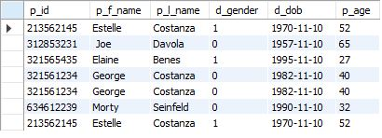
Doctor Queries:
# 1 - for a given doctor id show all the prescriptions he wrote
DELIMITER $$
CREATE PROCEDURE DisplayPrescriptionsWrittenByDoctor( in did INT)
BEGIN
select * from session, prescription where session.s_id = prescription.s_id and session.d_id = did;
END$$
DELIMITER ;
call DisplayPrescriptionsWrittenByDoctor(341270222);
# 2 - for a given doctor id show all his patients
DELIMITER $$
CREATE PROCEDURE ShowPatientsOfDoctor( in did INT)
BEGIN
select patient.* from patient, session where patient.p_id = session.p_id and session.d_id = did;
END$$
DELIMITER ;
call ShowPatientsOfDoctor(341270222);

Slide 23
# 3 - for a given doctor id display his manager info
DELIMITER $$
CREATE PROCEDURE DisplayManagerOfDoctor( in did INT)
BEGIN
select * from doctor,
(select doctor.manager_id from doctor where doctor.d_id = did) as TMP
where doctor.d_id = TMP.manager_id;
END$$
DELIMITER ;
call DisplayManagerOfDoctor(341270222);
# 4 - for a given doctor id show all sessions that had more than 1 line in prescription
DELIMITER $$
CREATE PROCEDURE ShowPrescriptionsWithMoreThanOneLineWrittenByDoctor( in did INT)
BEGIN
select *from session,
(select prescription.prsc_id, prescription.s_id, count(prescription.prsc_id) as lip_count
from prescription, Lines_In_Prescription as lip
Where prescription.prsc_id = lip.prsc_id
group by prescription.prsc_id) as TMPwhere session.d_id = 341270222 and session.s_id = TMP.s_id and TMP.lip_count > 1;
END$$
DELIMITER ;
call ShowPrescriptionsWithMoreThanOneLineWrittenByDoctor(341270222);

Slide 24


# 5 - for a given doctor id count the number of session he had.
DELIMITER $$
CREATE PROCEDURE ShowNumberOfsessionOfDoctor( in did INT)
BEGIN
select TMP.d_id, TMP.session_count from
(select *, count(session.d_id) as session_count from session group by session.d_id) as TMP
where TMP.d_id = did;
END$$
DELIMITER ;
call ShowNumberOfsessionOfDoctor(341270222);
# 6 - for a given doctor id display the medicines he prescribed
DELIMITER $$
CREATE PROCEDURE ShowMedicinesDoctorPrescribed( in did INT)
BEGIN
select medicine.* from medicine
inner join
(select prescription.s_id, prescription.prsc_id, lip.m_id
from session, prescription, Lines_In_Prescription as lip
where session.s_id = prescription.s_id and prescription.prsc_id = lip.prsc_id and session.d_id = did) as TMP
ON TMP.m_id = medicine.m_id;
END$$
DELIMITER ;
call ShowMedicinesDoctorPrescribed(341270222);

Slide 25


# 7 - for a given doctor id display the number of prescriptions he wrote
DELIMITER $$
CREATE PROCEDURE SHowNumberOfPrescriptionsWrittenByDoctor( in did INT)
BEGIN
select count(session.d_id) as num_of_prsc_written from session, prescription
where session.s_id = prescription.s_id and session.d_id = did group by session.d_id;
END$$
DELIMITER ;
call SHowNumberOfPrescriptionsWrittenByDoctor(341270222);
# 8 - for a given doctor id show the number of diagnostics he gave
DELIMITER $$
CREATE PROCEDURE ShowNumOfDiagnosisByDoctor( in did INT)
BEGIN
select count(session.d_id) as NUM_OF_DIAG_BY_DOCTOR from Session, DOS where Session.s_id = DOS.s_id and session.d_id = did group by session.d_id;
END$$
DELIMITER ;
call ShowNumOfDiagnosisByDoctor(341270111);

Slide 26

# 9 - for a given doctor id show the session that had a diagnosis of diabetes
DELIMITER $$
CREATE PROCEDURE ShowSessionofDoctorWithDiabetes( in did INT)
BEGIN
select session.*, diagnosis.diag_name as Diagnosis from diagnosis, DOS, Session
where diagnosis.diag_id = DOS.diag_id and DOS.s_id = session.s_id and diagnosis.diag_name like "diabetes" and session.d_id = did;
END$$
DELIMITER ;
call ShowSessionofDoctorWithDiabetes(341270222);
# 10 - for a given doctor id display his schedule
DELIMITER $$
CREATE PROCEDURE DisplayDoctorSchedules( in did INT)
BEGIN
select * from schedules as sc where sc.d_id = did;
END$$
DELIMITER ;
call DisplayDoctorSchedules(341270111);

Slide 27

Manager Queries:
# 1 - display the doctor that diagnosed the youngest patient with diabetes
select doctor.*from Session, DOS, doctor,
(select TMP2.p_id
From (select min(patient.p_age) as p_age from DOS, Session, patient
where DOS.s_id = Session.s_id and Session.p_id = patient.p_id and DOS.diag_id = 104) as TMP1,
(select patient.* from DOS, Session, patient where DOS.s_id = Session.s_id and Session.p_id = patient.p_id and DOS.diag_id = 104) as TMP2
Where TMP2.p_age = TMP1.p_age) as TMP1
Where Session.p_id = TMP1.p_id and Session.s_id = DOS.s_id and DOS.diag_id = 104 and doctor.d_id = Session.d_id;
# 2 - Display all the male Patients that are older than 45 , sorted by asc age
select pa.* from Patient as pa
where pa.d_gender = 0
and pa.d_age >= 45
order by d_age asc;

Slide 28



# 3 - Display all female doctors in age btween 35 and 59 , sorted by asc age
select doc.*
from Doctor as doc
where doc.d_gender = 1 and d_dob BETWEEN '1963-12-25' AND '1987-12-31' order by d_age asc;
# 4 - Display all doctors with more than 10 years of experience sorted by years of exp desc
select doc.d_f_name,doc.d_l_name,doc.d_years_of_exp
from Doctor as doc
where d_years_of_exp >9 order by d_years_of_exp desc;
# 5 - Display all the doctors specific last name
DELIMITER $$
CREATE PROCEDURE GetAllDoctorWithThisLastName( in last_name varchar(255))
BEGIN
SELECT d_f_name,d_l_name FROM Clinic_2022.doctor
where d_l_name=last_name;
END$$
DELIMITER ;
call GetAllDoctorWithThisLastName('Geller');

Slide 29


# 6 - Display all Prescription(including lines) written by a specific doctor
DELIMITER $$
CREATE PROCEDURE GetPrcPerDoc5( in last_name varchar(255))
BEGINselect line.prsc_id,Medicine.m_name,line.lip_amount
from Lines_In_Prescription as line,(select pre.prsc_id
From Prescription as pre,Session as si,Doctor as doc
where doc.d_id = si.d_id and pre.s_id = si.s_id and doc.d_l_name =last_name) as tmp,Medicine
where tmp.prsc_id = line.prsc_id and line.m_id =Medicine.m_id;
END$$
DELIMITER ;
call GetPrcPerDoc5('Geller’);
# 7 - Display all Prescription that been given in a specific day
DELIMITER $$
CREATE PROCEDURE GetPrscInDate1( in in_date1 varchar(255))BEGINselect line.prsc_id,Medicine.m_name,line.lip_amount as amount
from Lines_In_Prescription as line,(select pre.prsc_id from Prescription as pre,Session as si,Patient as pai
where pai.p_id = si.p_id and pre.s_id = si.s_id and si.s_date = in_date1) as tmp,Medicine
where tmp.prsc_id = line.prsc_id and line.m_id =Medicine.m_id;
END$$
DELIMITER ;
call GetPrscInDate1("2022-1-4");

Slide 30

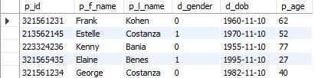
# 8 - Display Doctor information who wrote the most diagnostics
select *fromdoctor,
(select TMP1.d_id, TMP1.diag_count
From (select Session.d_id, count(Session.d_id) as diag_count from Session, DOS
where Session.s_id = DOS.s_id group by Session.d_id) as TMP1,
(select max(TMP1.diagnostic_count) as max_diag_count from
(select count(Session.d_id) as diagnostic_count from Session, DOS
where Session.s_id = DOS.s_id group by Session.d_id) as TMP1) as TMP2
Where TMP1.diag_count = TMP2.max_diag_count) as TMP
where doctor.d_id = TMP.d_id;
# 9 Display the first name of all patients who had HGB > 16
select patient.p_f_name from patient, Session, analysis
where analysis.s_id = session.s_id and analysis.a_HGB > 16 and patient.p_id = Session.p_id;
# 10 - Display all the Patients who ever had a session in a specific room
select patient.*from patient,
(select * from Session where Session.r_num = 3) as TMP
where patient.p_id = TMP.p_id;

Slide 31
commands to be executed by the user:
Insert:
DELIMITER $$
CREATE PROCEDURE AddPatientProcedure( in pid INT, pfname CHAR(25), plname CHAR(25), pgender BOOL, pDOB DATE, patientage FLOAT )
BEGIN
insert into Patient values
(pid, pfname, plname, pgender, pDOB,patientage);
END$$
DELIMITER ;
call AddPatientProcedure(316559837, "Rick", "Sanchez", 0, '1969-1-1', 52);
call AddPatientProcedure(316559838, "Morty", "Smith", 0, '2000-1-1', 22);
Update:
DELIMITER $$
CREATE PROCEDURE UpdatePatientFirstNameProcedure( in pid INT, pfname CHAR(25))
BEGIN
UPDATE Patient SET Patient.p_f_name = pfname
WHERE Patient.p_id = pid;
END$$
DELIMITER ;
call UpdatePatientFirstNameProcedure(316559837, "Rick1");
call UpdatePatientFirstNameProcedure(316559838, "Morty1");
Delete:
DELIMITER $$
CREATE PROCEDURE DeletePatientProcedure( in pid INT)
BEGIN
DELETE FROM Patient WHERE Patient.p_id = pid;
END$$
DELIMITER ;
call DeletePatientProcedure(316559837);
call DeletePatientProcedure(316559838);

Slide 32
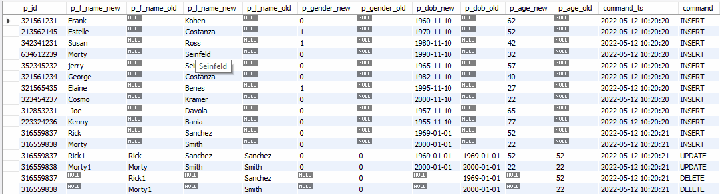
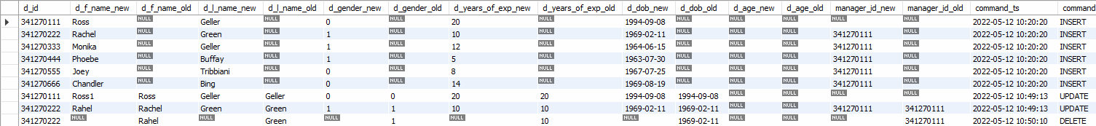
Logs:
select * from patient_log;
select * from doctor_log;

Slide 33
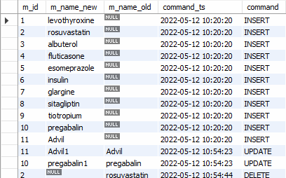
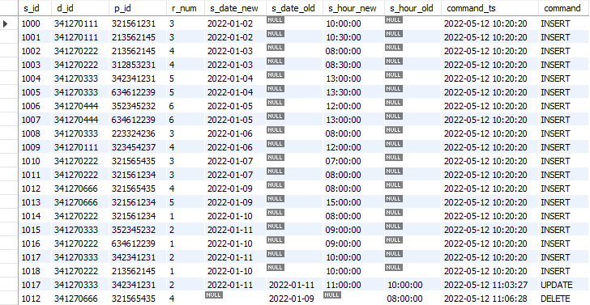
select * from medicine_log;
select * from session_log;

